Slide 1
Coastal Bend Business Innovation Center
Regional EDA University Conference
Russell Franques, Associate Director of Client Relations
March 8-10, 2017

Slide 2
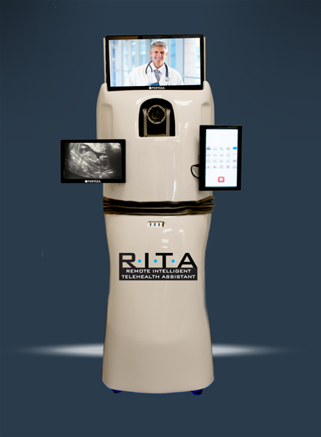
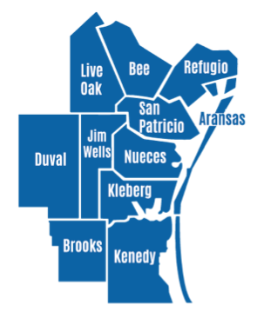
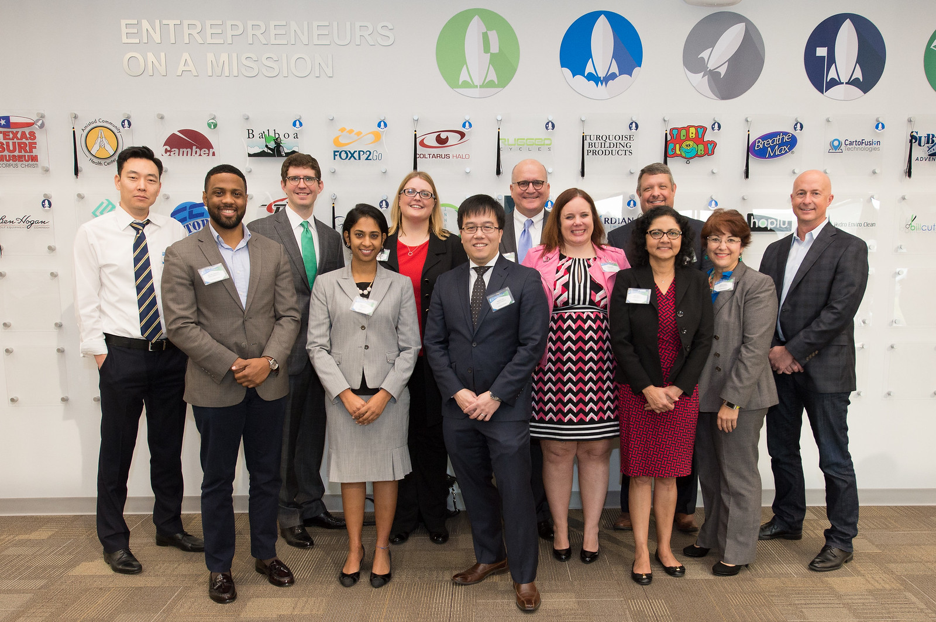
What are the needs and how do we meet them?
1
Economic Diversification
Rural Outreach
High-impact Educational Offerings
Lone Star UAS Center of Excellence and Innovation
Soft Landing clients
Need vary by geography
11 county outreach program through the Governor’s Office grant
Topics selected based on client and community feedback

Slide 3
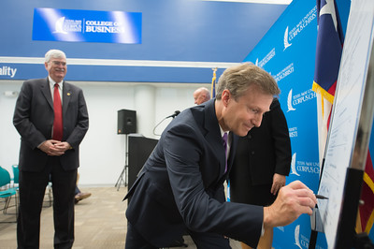
What are the needs and how do we meet them?
2
Veteran Businesses
Entrepreneurial Ecosystem
Strategic Alliance Memorandum with the Small Business Administration
Unified vision
Empower collaborative framework

Slide 4
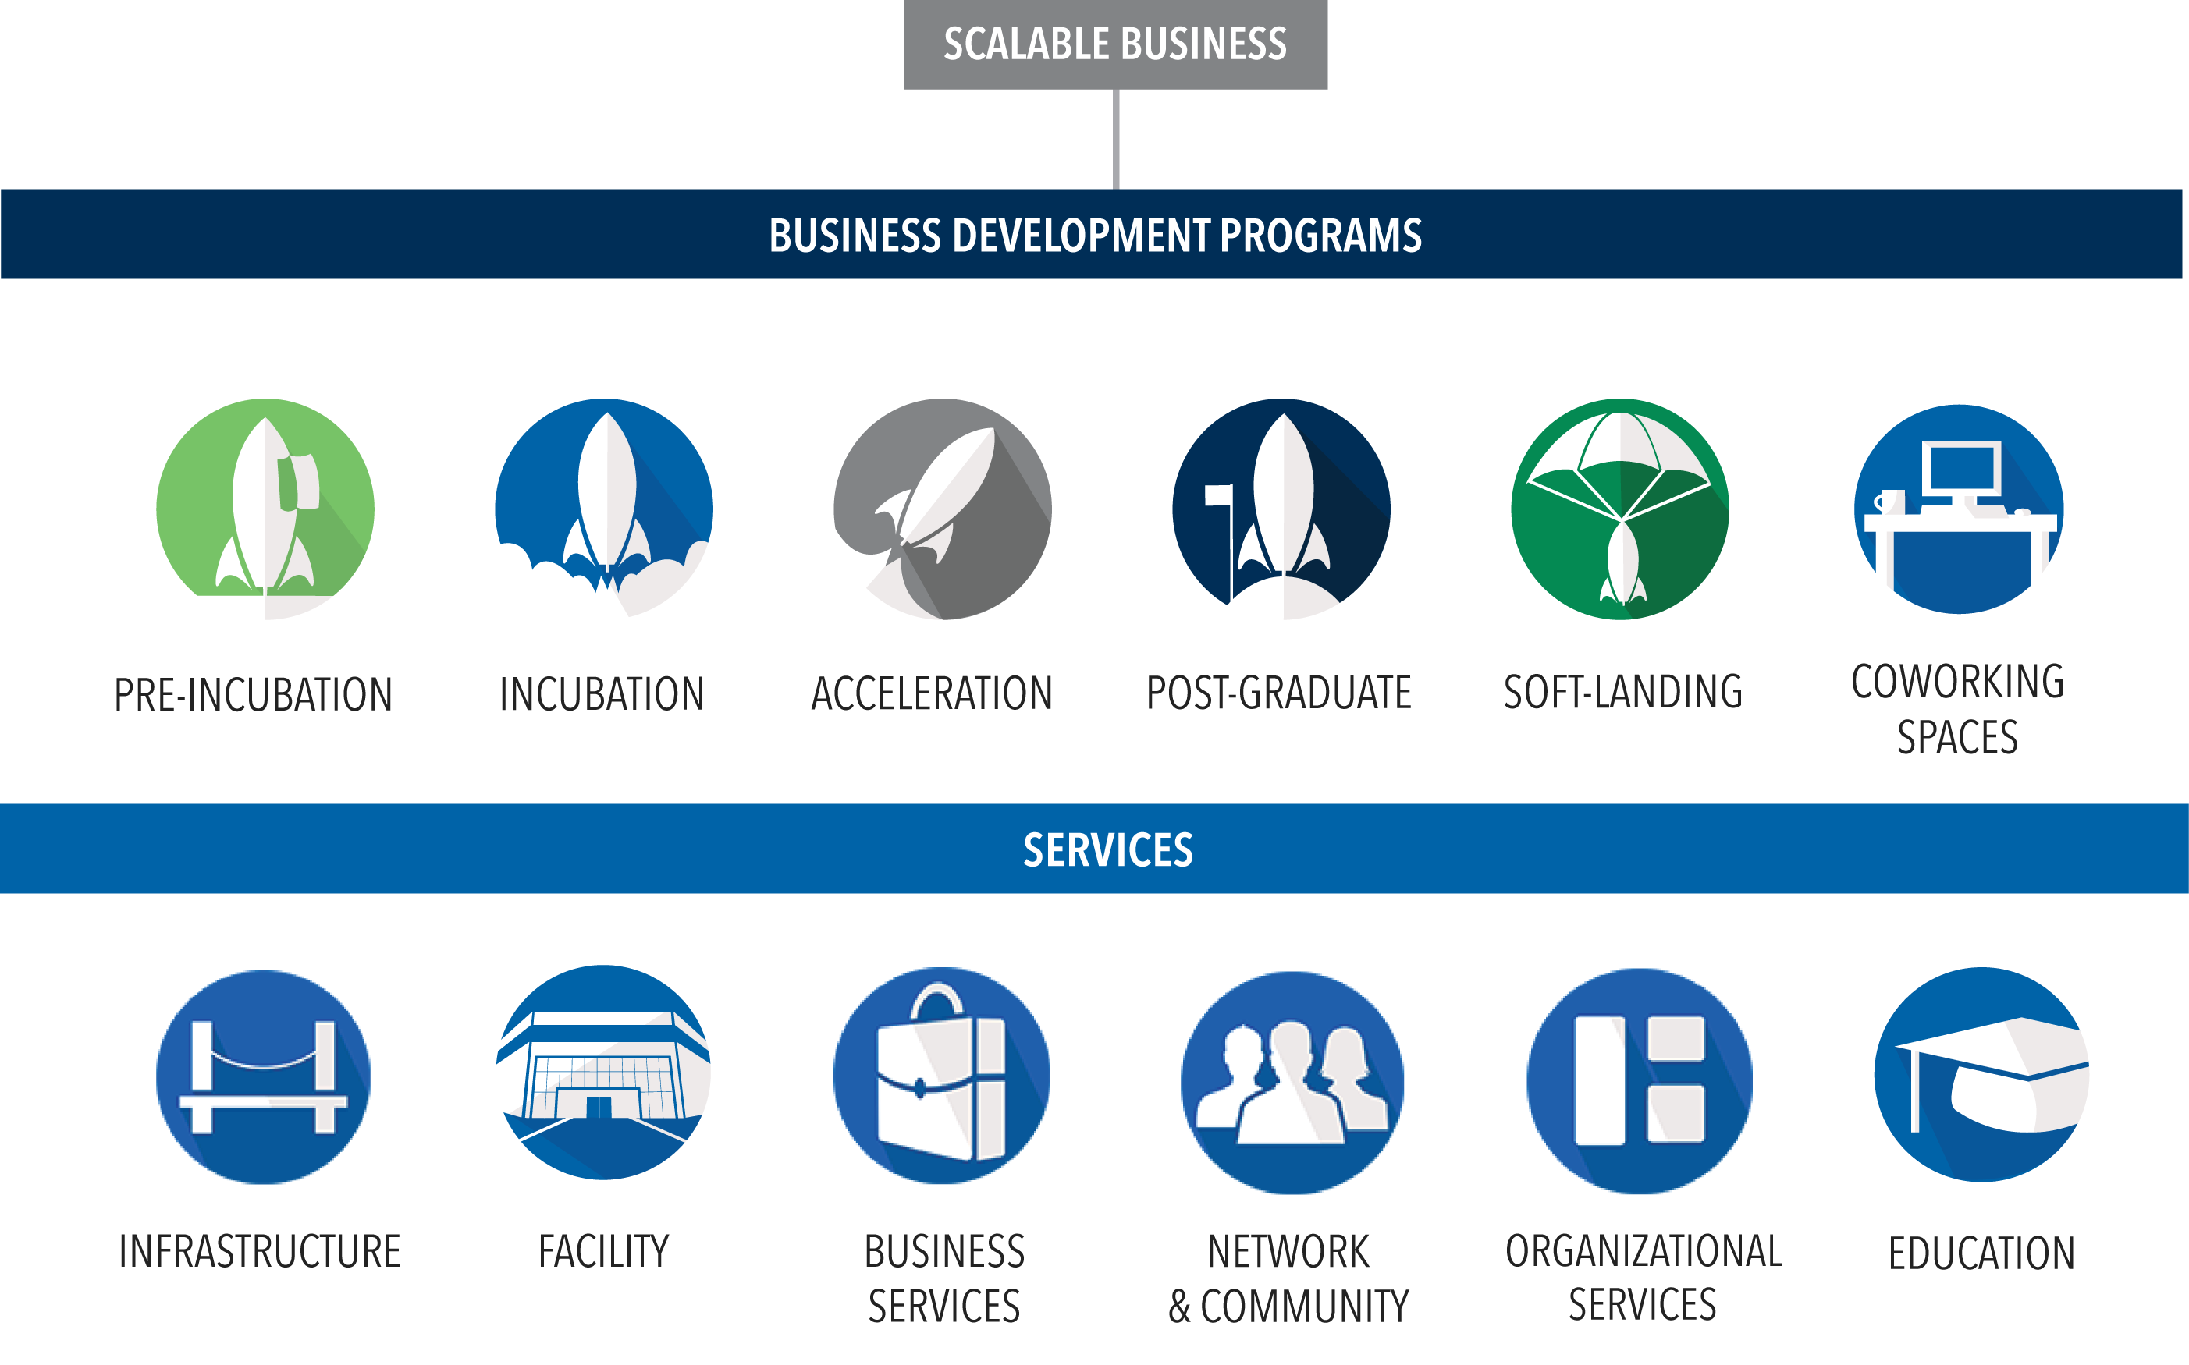
What are the needs and how do we meet them?
3

Slide 5
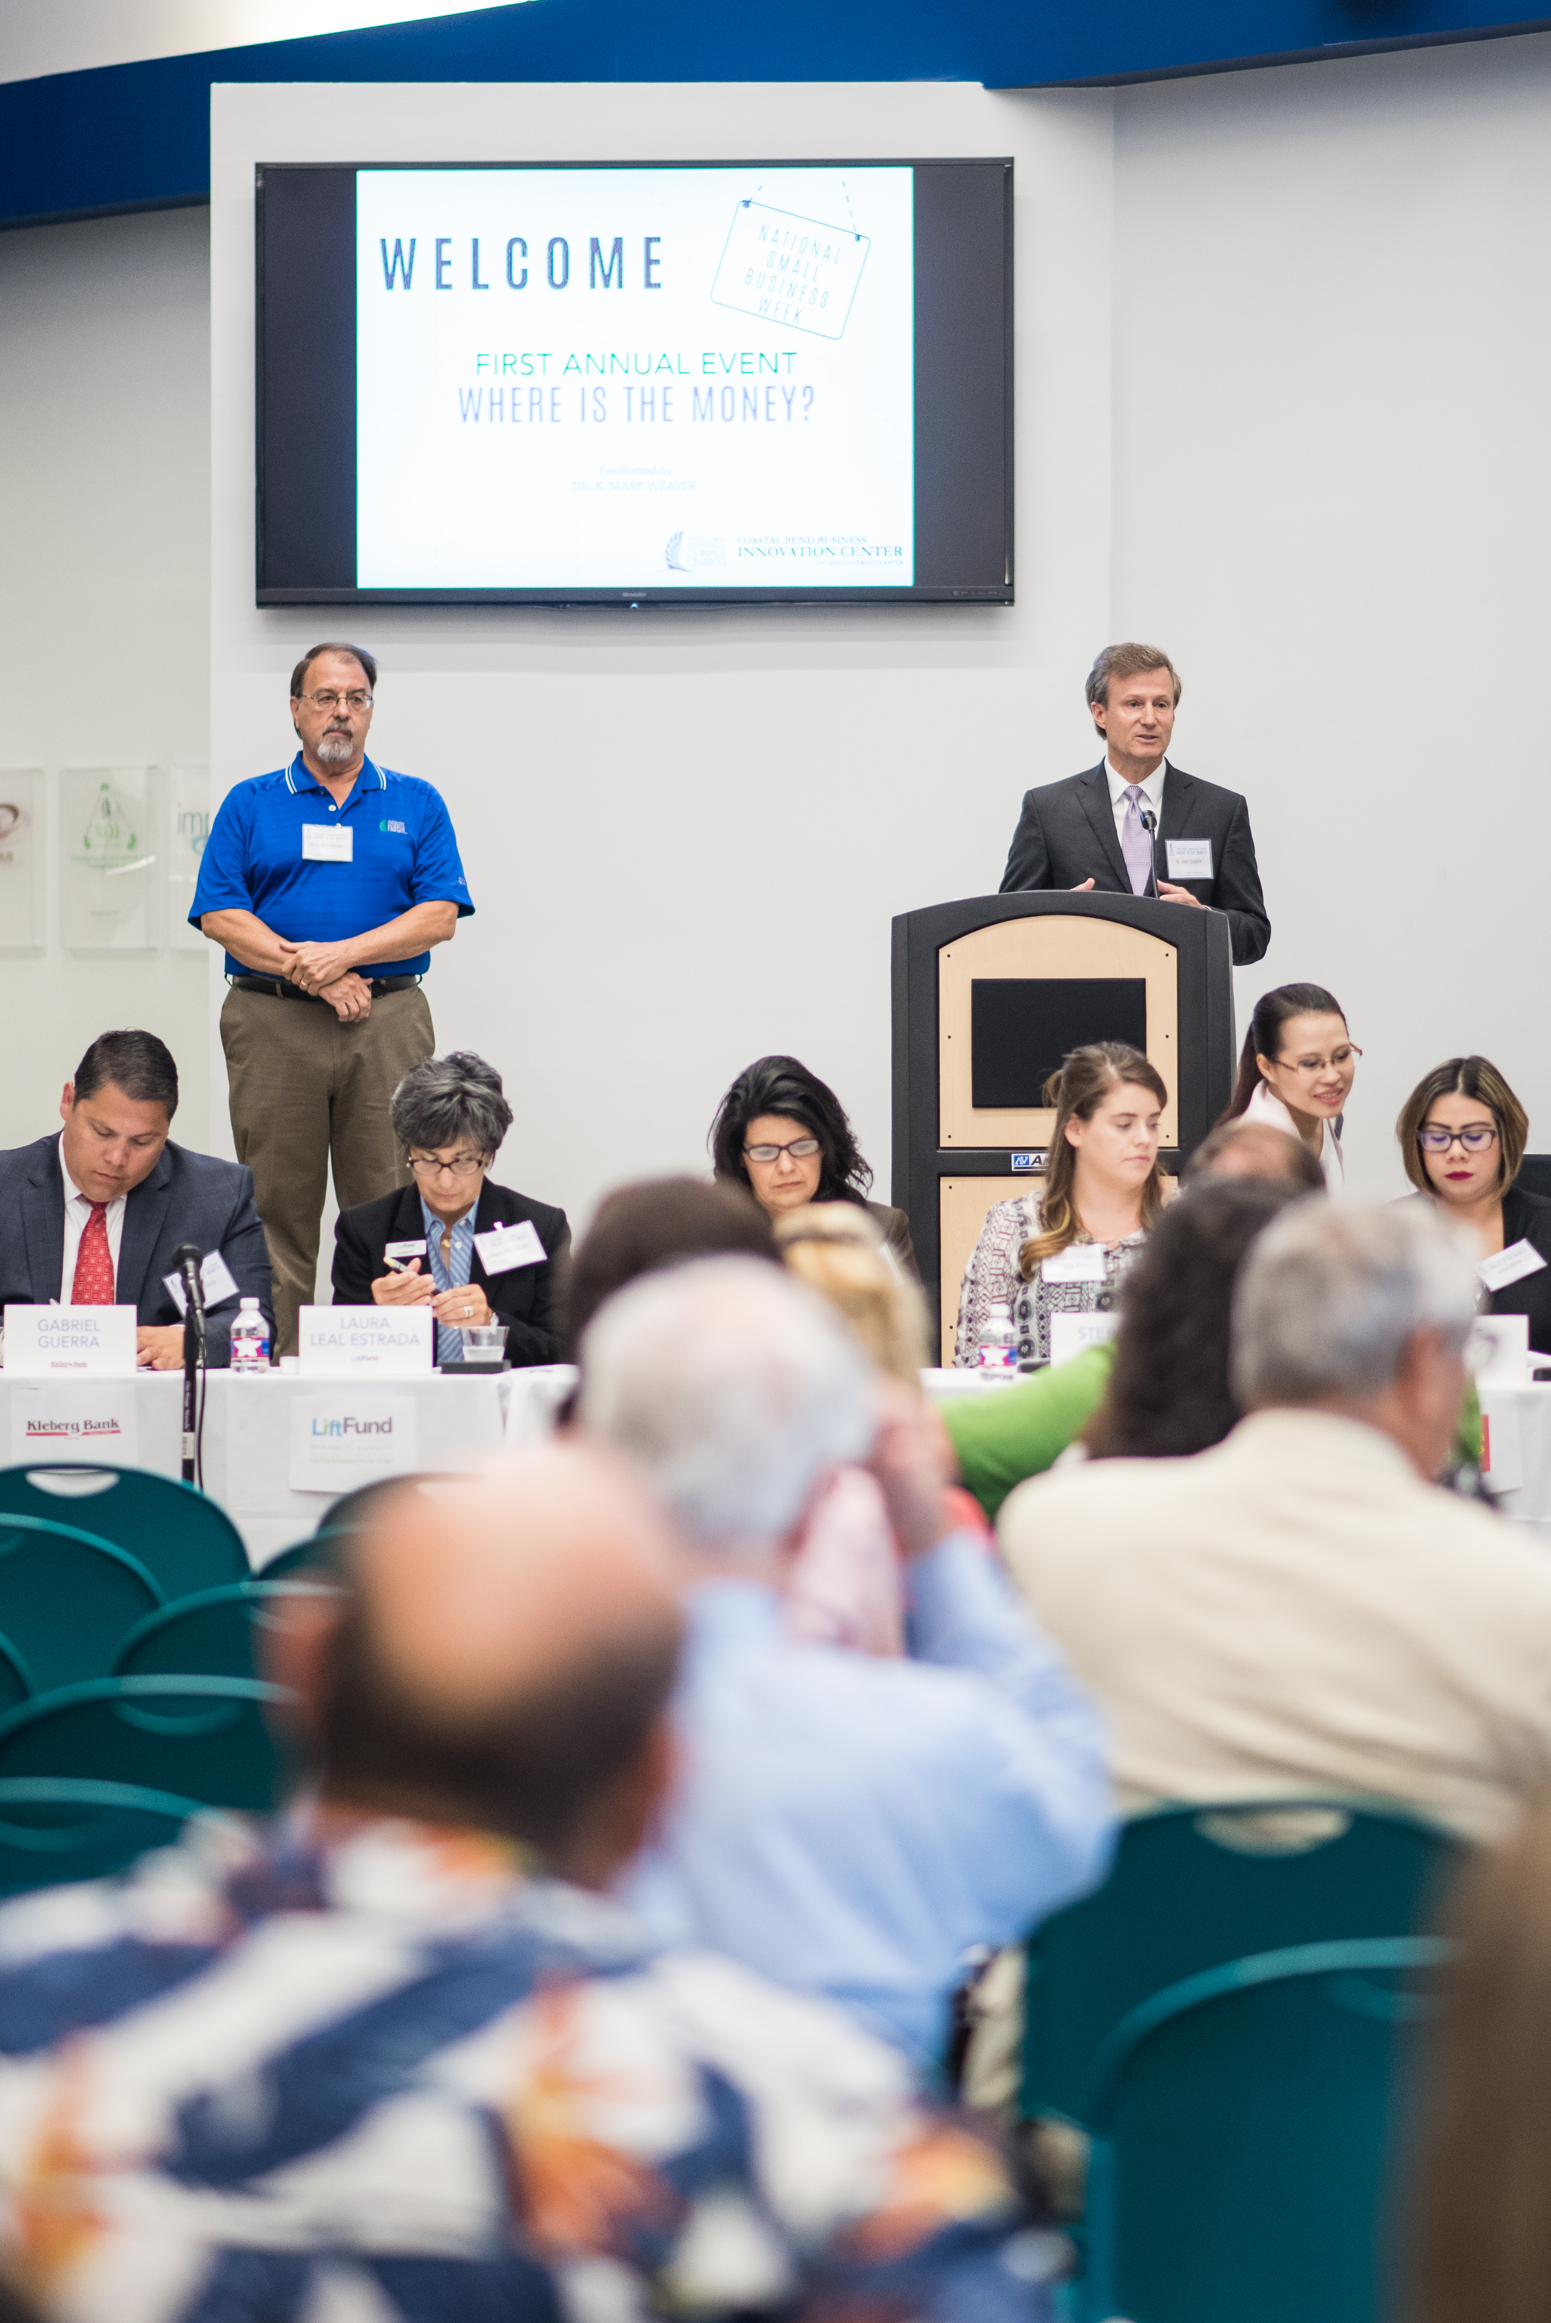
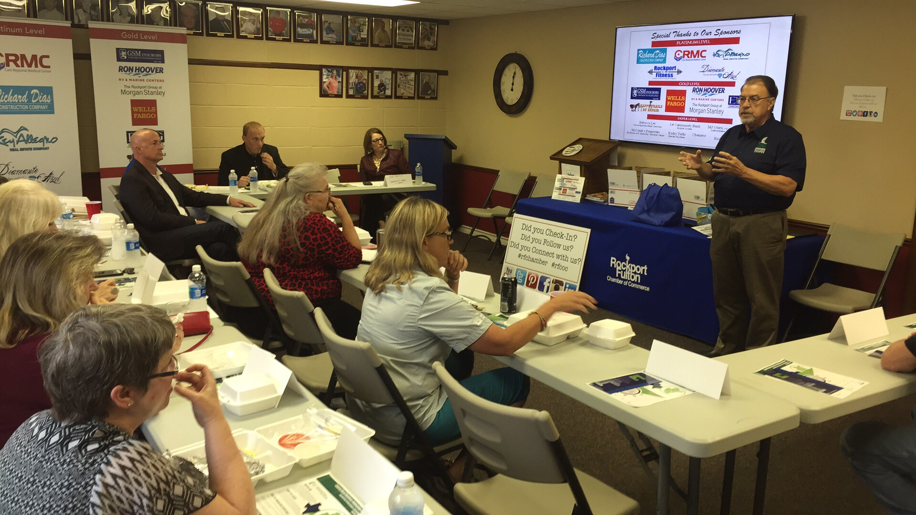
How to address key challenges?
4
Availability of Coders
Financing Availability
Rural Outreach
11 county outreach program through the Governor’s Office grant
Continue integration and collaboration
Pursue IT related companies
“Where is the Money?” (Record 102 participants)
Develop and administer South Coast Angel Network

Slide 6
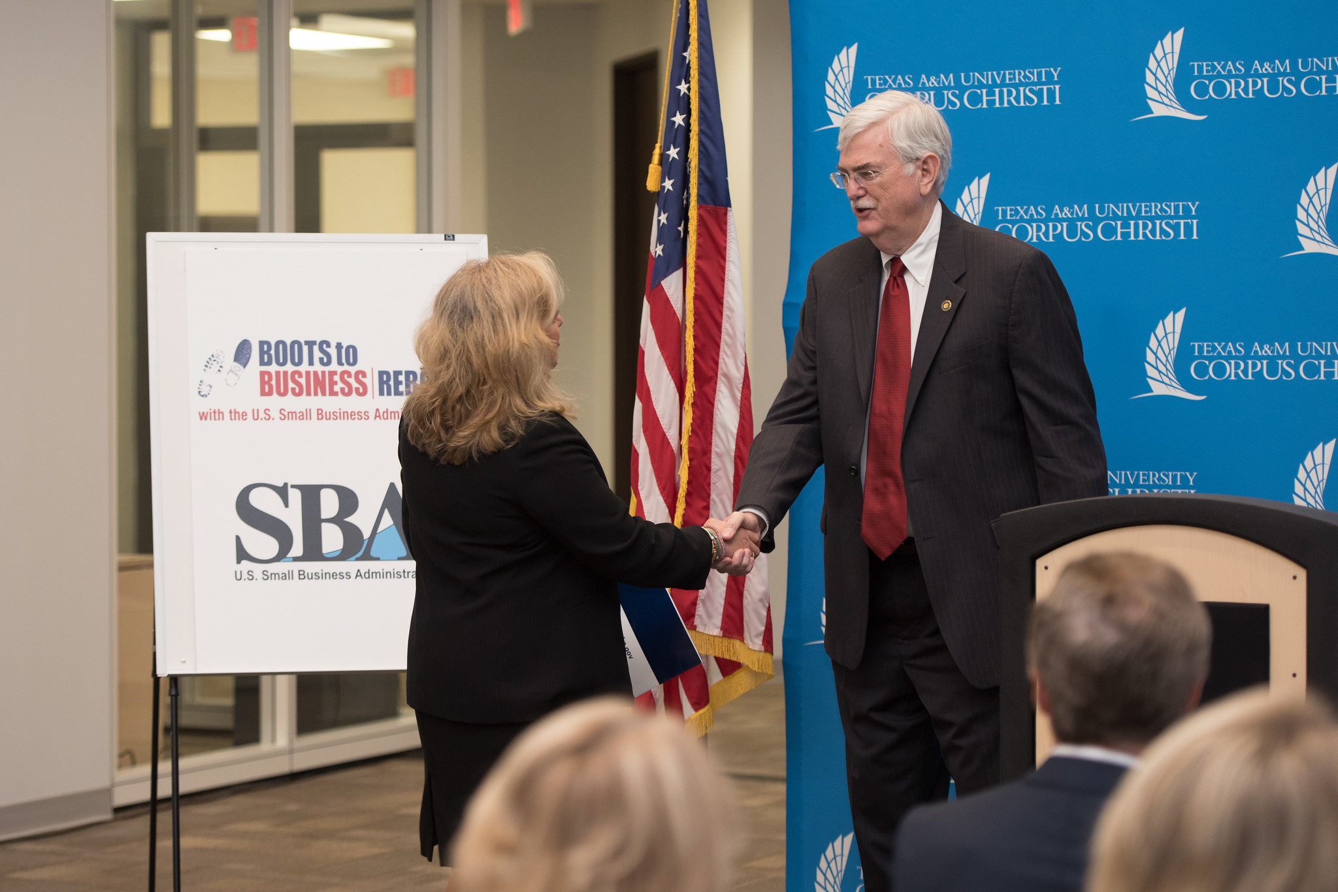
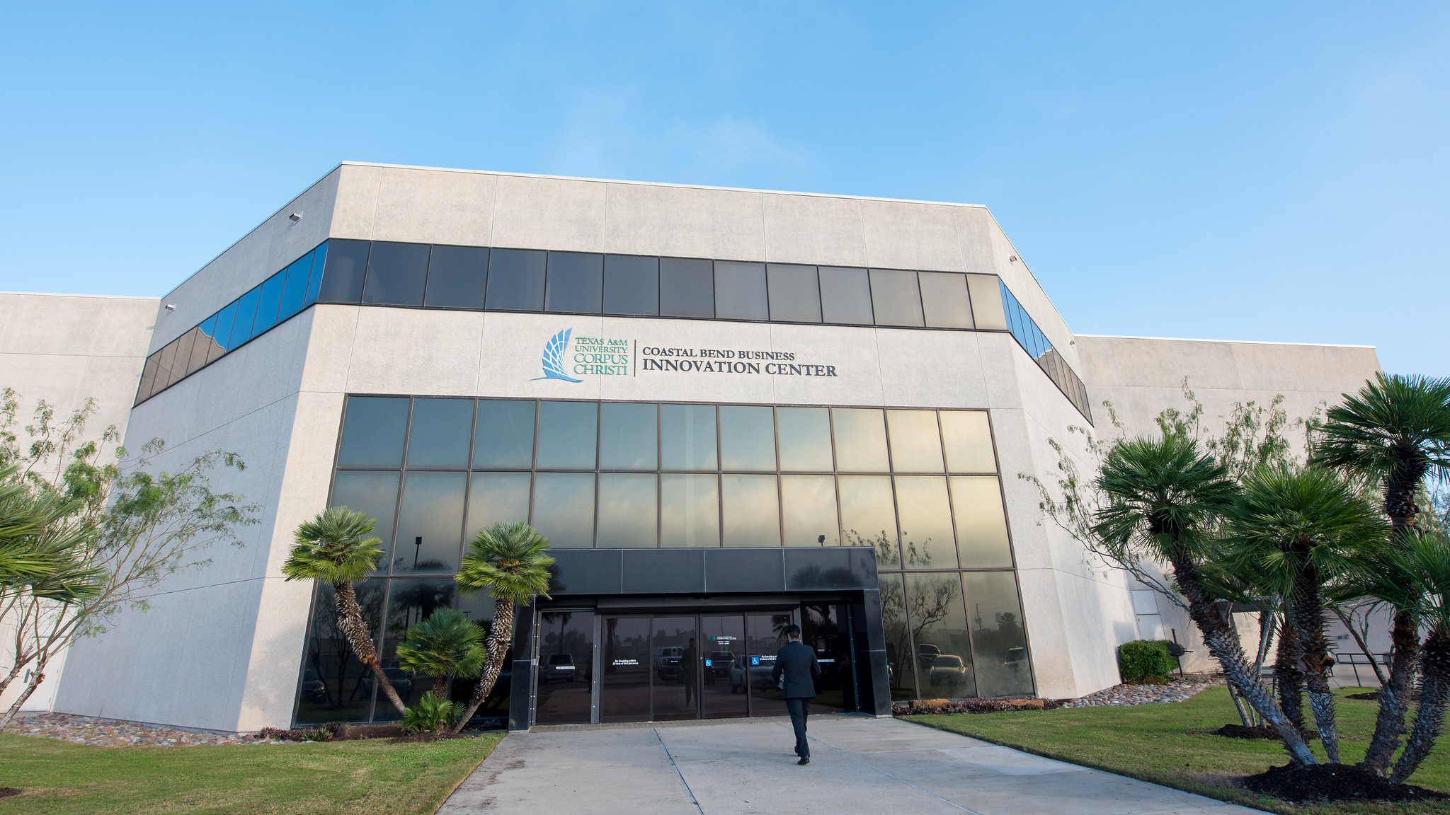
How to address key challenges?
5
Collaboration among orgs
Sustainability
MOU with CCREDC
SAM with SBA
Enhanced Onboarding Filters
Driving affiliate clients

Slide 7
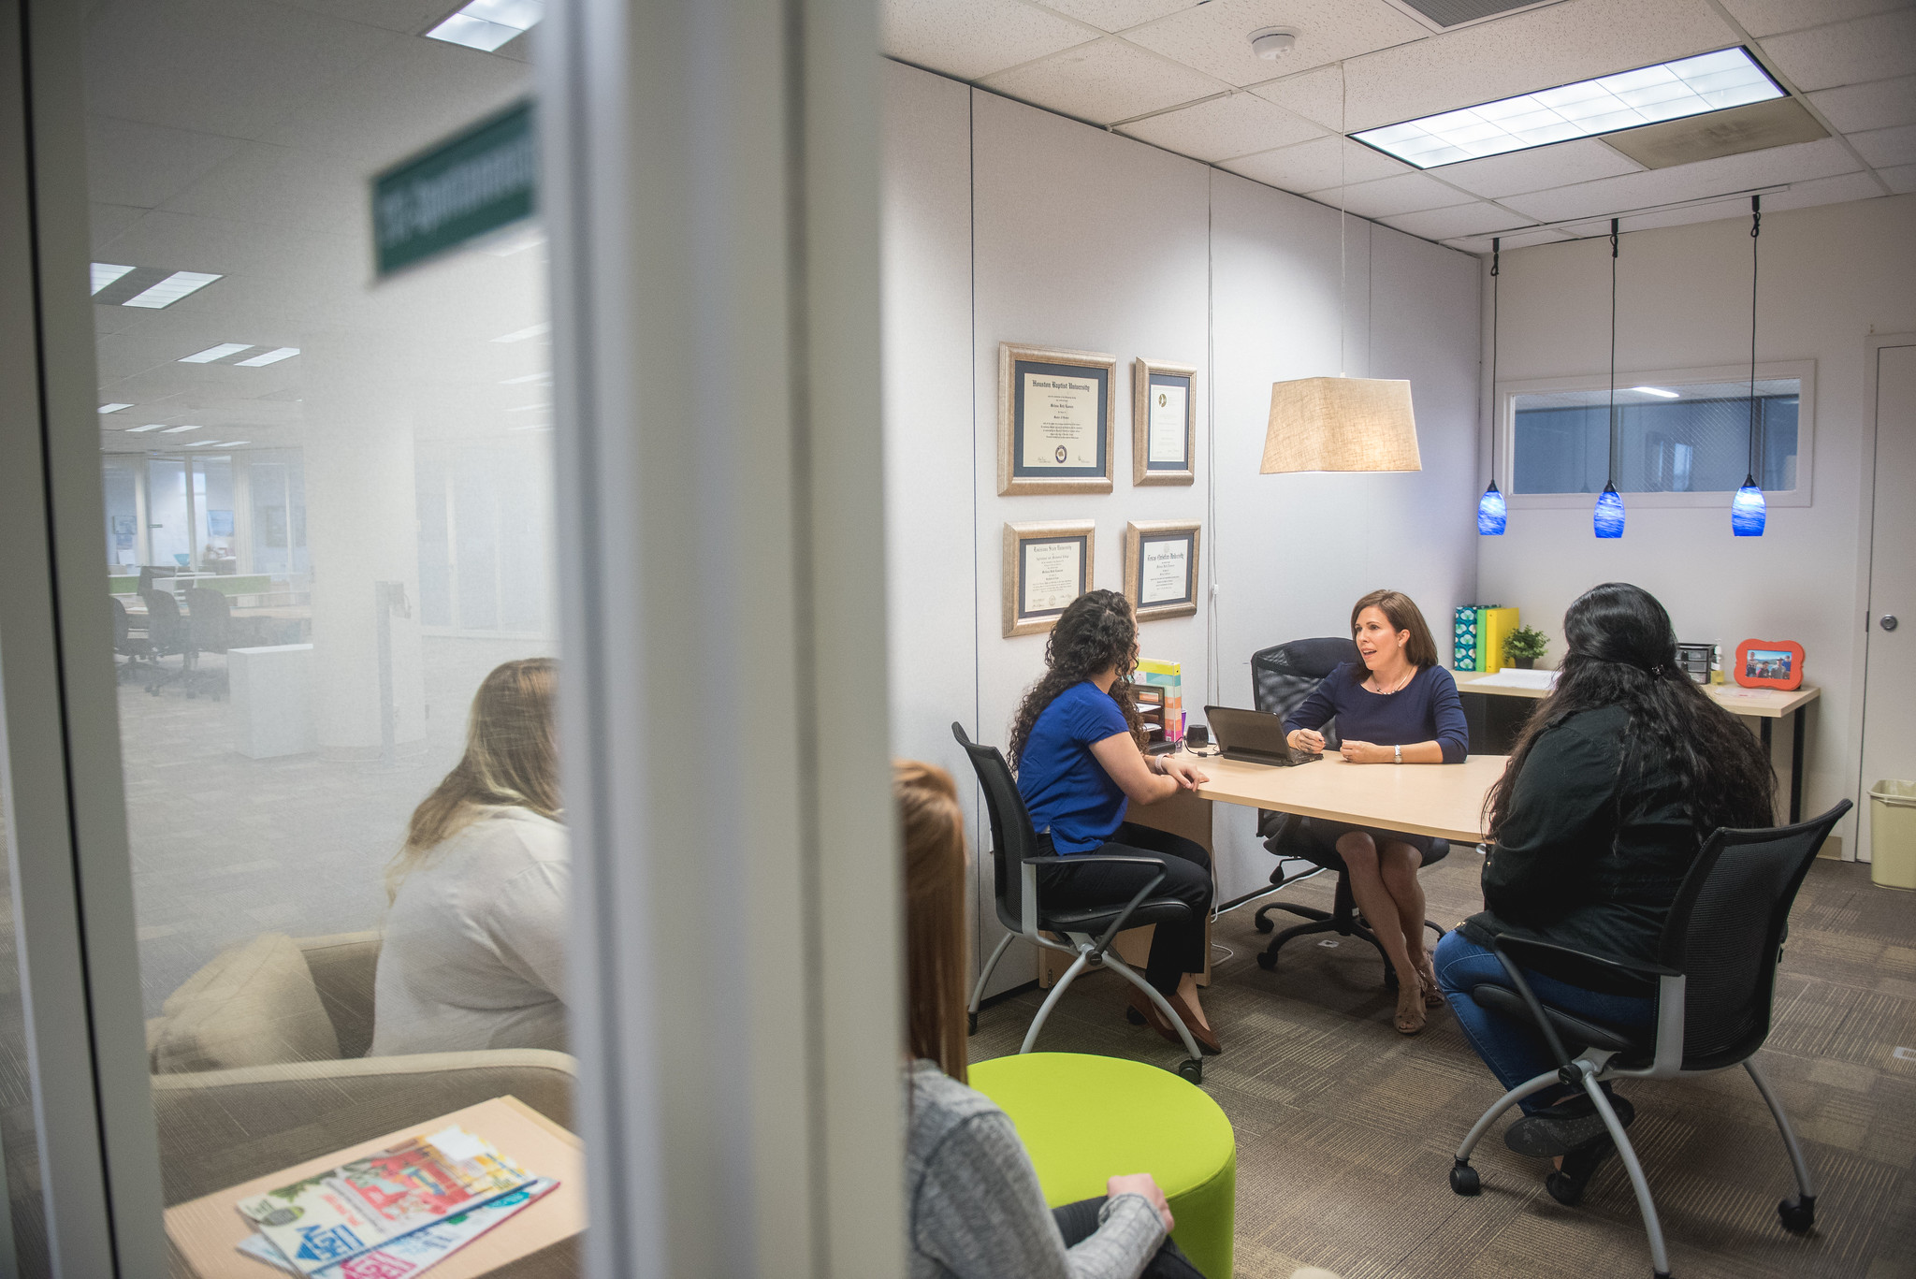
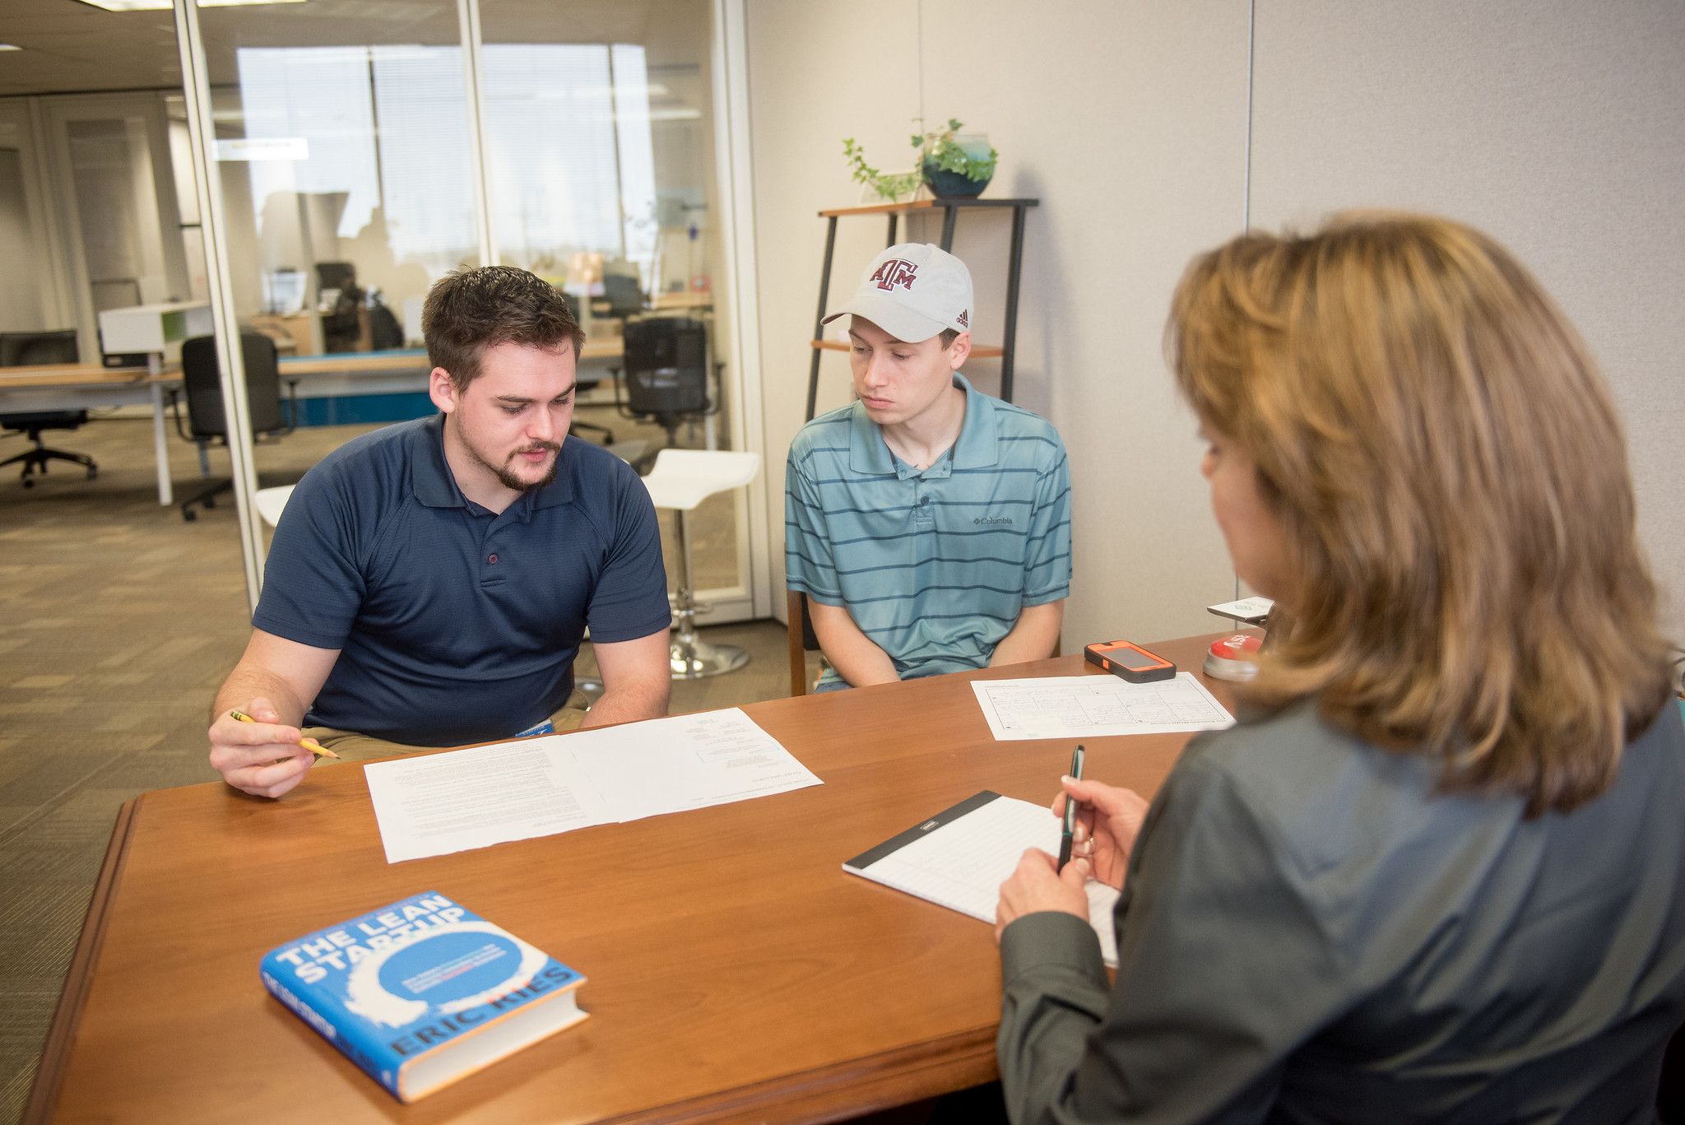
What did we learn?
6
Fail Fast Methodology
Proactive C-Suite Level Consulting
Cross Client Patronage
Shorten cycle time to failure to empower future success
From perceived needs, to proactive guidance
Provide guidance for integration opportunities
Facilitate use of services amongst clients

Slide 8
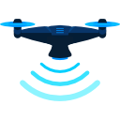
What comes next?
7
Lone Star UAS Center of Excellence and Innovation
Enhanced Partnership with CCREDC
Unified strategy for economic development with Corpus Christi Regional Economic Development Corporation (CCREDC)
Attract UAS related businesses to the Coastal Bend
Proactively seek out Soft Landing Clients

Slide 9
What comes next?
8

Slide 10
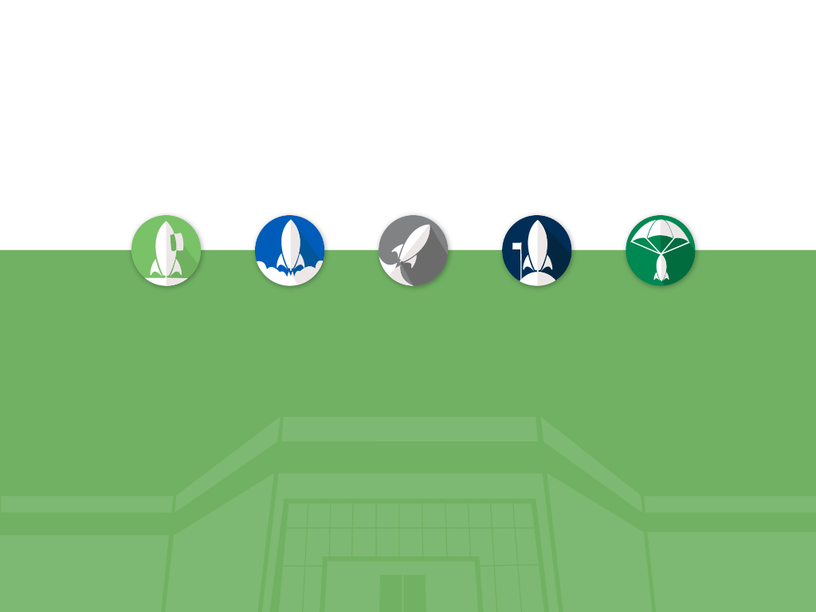
QUESTIONS

