Slide 1
UTRGV Center for Innovation and Commercialization (CIC)
EDA University Center Conference
March 9, 2017

Slide 2
Underdeveloped and Disjointed Entrepreneurial Ecosystem Lack of Support System for Entrepreneurs and Innovators Lack of Resources and Access to Capital

Slide 3
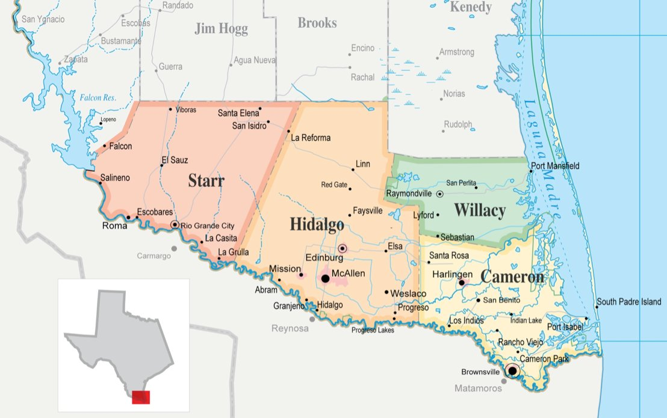
Service Area
Many support organizations
University / CCs
SBDC
EDCs
SBA/Score
TMAC
Chambers of Commerce
Incubators/Co-Working Space

Slide 4
Our Goal
Become the
Regional Hub of Innovation and Venture Development by Providing University Resources

Slide 5
Programing and Services for the Community
Ideation and Business Modeling for Companies
Business Plans
Market Research
Access to Faculty, Staff and Students
Access to Mentors
Market Specific Interns
Workshops (i.e. entrepreneurship, marketing strategy, manufacturing, legal issues, and funding
Access to Capital – The Rio Grande Valley Angel Network

Slide 6
Student Engagement
Experiential Learning
Interdisciplinary Entrepreneurship
Internship Opportunities
Mentoring
Student Business Plan Competition
Workshops / Seminars
Creating a Culture of Entrepreneurship

Slide 7
Making an Impact
By The Numbers Since Inception
Start-up business projects: 37
Business models: 32
Business plans: 5
Student Teams: 185 students
MBA students: 82
Undergraduates: 103
Jobs created: 10
Intellectual property: 3 patent applications

Slide 8
Challenges
Lack of New Business Ideas and Deal Flow
Lack of knowledge as to What is Available
Disjointed Services and Resources
Providing Services Year Round / Rather than by Semester
Providing Value to the Company
Accessibility to Prototyping
Workshops for the Business Community/Campus
Presentations to EDCs, Chambers, Innovation
Creating an Asset Map of Resources (Campus/Regional)
Developing a curriculum/ class credits outside a traditional semester Providing Subject Matter Experts and Mentors for Real World Experience
Developing Relationship with Internal and Outside Resources

Slide 9
Setbacks? YES!
In the beginning stages, we were not familiar with the needs of our community entrepreneurs.
As we developed a proper vetting process, we realized some projects that we worked on were not feasible and should have not been accepted in our program.
Financial constraints lead us to develop our own in-house business development methodology. Throughout the implementation process, this methodology was modified and redefined.
No organized method of tracking companies / metrics

Slide 10
We have learned that implementing a proper business development methodology for venture creation is a gradual process.

Slide 11
…and that benchmarking and sharing best practices is essential for the success of our center.

Slide 12
The Center for Innovation and Commercialization of Tomorrow

Slide 13
Big Things are Coming

Slide 14
Floor Plan

Slide 15
Center for innovation and commercialization
$1.4M awarded from the EDA
$1.3M awarded from the Weslaco EDC
Total awards: $2.7M
Centrally located in the Mid-Valley
Construction begins Spring 2017
Opening December 2017

Slide 16
More Programming
Pre-Incubation (Idea Stage)
Help entrepreneurs develop a business proposition and visualize business opportunity
Bridge Program (Validation and Prototyping)
Help entrepreneurs identify revenue sources, customer base, products, and details of financing
Early Stage (Incubation)
Primary objective is to produce successful and financially viable firms that can survive on their own
Soft Landing
Feasibility studies to help foreign companies test the market in terms of competitiveness, demand, and regulations before making further investment.
Directory of Partner Service Providers and Capital Investors
Directory where entrepreneurs can seek and receive assistance with their relevant legal, marketing, and financial questions

Slide 17
More Offerings
Office space
Co-Working space
Common areas
Multiple conference rooms
Makers Space (3D Printing & Prototyping)
Technology resources (Wi-Fi, WebEx, laptops, desktops)
Classroom space
Internship opportunities for students
Mentoring
Workshops (i.e. entrepreneurship, marketing strategy, manufacturing, legal issues, and funding)

Slide 18
Additional Plans
Create a Regional Innovation and Entrepreneurship Council
Support Regional Initiatives to Promote Entrepreneurship
Train Entrepreneurial Coaches/Concierges.
Recruit a Cadre of Mentors – Develop Mentorship Program
Develop an Idea/Deal Flow Centralized Portal
Implement Salesforce to Track Companies and Metrics
7. Become an NSF I-Corps site (applied 2/17)

Slide 19
The Future is Exciting
One region, One mission
Innovating with purpose to create a plan for connecting our region’s assets
Integrating startup activity into a larger regional plan for starting, growing, attracting and retaining great businesses.

Slide 20
Thank You!
For more information on the Center for Innovation and Commercialization contact:
Laurie G. Simmons
Laurie.Simmons@utrgv.edu
(956)-357-0167

