Slide 1
NEW GPRA Reporting Requirements
For RLF Grantees
February 2021

Slide 2
Performance measurement at EDA
“Old” vs. “New” Performance Data Collection for Non-infrastructure programs
New Metrics and Data Collection for Non-infrastructure portfolio a.k.a “the new GPRA for non-infrastructure portfolio”
What’s next?!

Slide 3
EDA collects and reports on performance measures in compliance with Government Performance and Results Act of 1993 that, as amended by the GPRA Modernization Act of 2010, establishes requirements for all agencies to collect, analyze and report on their performance.
EDA Performance Goal 1: Infrastructure investments that promote private enterprise and job creation in economically distressed communities and regions. (Public Works, Economic Adjustment Assistance (Construction & Revolving Loan Funds*)
EDA Performance Goal 2: Non-infrastructure investments that build community capacity to achieve and sustain regional competitiveness and economic growth.
https://www.eda.gov/performance/
*RLFs awarded after 06/2020 will be subject to new non-infrastructure metrics collection under Goal 2.

Slide 4
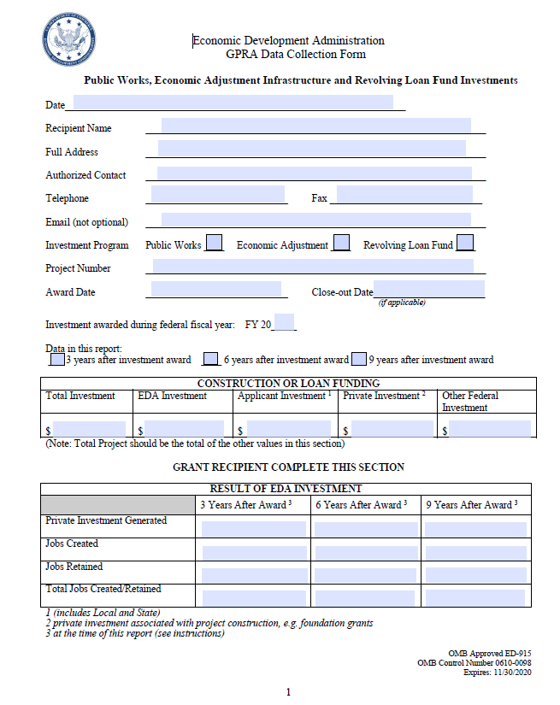
“Old” Data Collection Forms
ED-915 GPRA Data Collection Form: Public Works, Economic Adjustment Infrastructure and Revolving Loan Fund Investments (PDF)
ED-916 GPRA Data Collection Form: Economic Development Districts and Indian Tribes (PDF)
ED-917 GPRA Data Collection Form: University Centers (PDF)
ED-918 GPRA Data Collection Form: Trade Adjustment Assistance Centers (PDF)

Slide 5
Old vs. New
Expired ED-916, ED-917, ED-918
NEW ED-916, ED-917, ED-918
Program-focused (Partnership Planning, University Centers, and Trade and Adjustment Assistance for Firms)
Narrow in scope (select outputs and outcomes)
PDF forms
Annual data collection
Apply to all of EDA’s non-infrastructure programs to accommodate a variety of projects and intended outcomes
Based on years of novel research by leading research institutions and EDA
Web-based instruments (Qualtrics) that allow for flexibility and easier record-keeping
Data collection:
Semi-Annual (ED-916) during the period of performance (outputs/activities)
Annual (ED-917 or ED-918) collection for five years (outcomes)

Slide 6
ED-915
*Please note: RLFs made before June 1, 2020 will continue to report on GPRA using the ED-915 until they receive a new award. The new GPRA process only applies to new awards made on or after June 1, 2020.

Slide 7
Economic Development Logic Model (non-infrastructure portfolio)
Initial Conditions
Inputs
Outputs
(Program Activities)
Capacity Outcomes
(Shorter Term)
Realized
Outcomes
(Longer Term)
Economic conditions / business cycle (regional, national, global)
Facilities & Equipment
Product, Production Processes & Business Capacities
Portfolio of Programs
Regional-Level:
Establishment Growth/Survival
Job Growth
Earnings/Wage Growth
Revenue/Sales Growth
Opportunities/ Equity
Increased share of cluster activity
Industry/cluster conditions, competitiveness & level of definition/ development
Events, Networking & Referrals
Markets & Business Networks
EDA Funding
R&D & Commercialization Support
Innovation, Technology Transfer & Commercialization
Existing regional networks & innovation ecosystems
Other Funding
Financing Support
Financing & Investment
Client/Participant Resources
Existing workforce skills & knowledge
Mentoring, Coaching & Training
Human Capital & Workforce
Existing
facilities
Planning & Institutional Development
Organizational Capacity
Notes:
The revised or “new” ED-916, ED-917, and ED-918 instruments are grounded in years of cooperative research between EDA and the leading research institutions including SRI International and UNC Chapel Hill.
One of the results of this research was the economic development logic model refined to fit a wide range of non-infrastructure economic development projects, the associated outputs and the intermediate, or capacity outcomes that were discovered to be key to sustainable long-term economic outcomes, as part of this research.
Building on this groundwork, SRI has been collaborating with EDA on the refinement of the logic model and validation of a set of metrics through an econometric model that measures and confirms (where possible) the statistical relationships among capacity outcomes and long term economic outcomes.
From left to right:, the logic model tracks Initial (or Baseline) Conditions and Capacities of a region where an applicant organization operates or region it serves, Inputs (such as government funding), outputs or program activities, capacity outcomes, intended to monitor a wide range of intermediate effects of the outputs or activities conducted under the scope of grant’s work, and realized outcomes longer term economic development outcomes .
We will focus on Program Outputs and Capacity outcomes since these are the data that we will be collecting

Slide 8
The NEW ED-916: Semi-annual Questionnaire on Outputs sponsored under an EDA grant
General Information
Capital Challenge Questions
Grant Number/Target Beneficiary
Facilities & Equipment: - Existing & new space & purpose (e.g., maker space/lab);
- Type & value of equipment
Mentoring, Coaching & Training
- # training/skill assistance sessions held
- # firms/participants - focus of training/skills assistance (e.g., project management, business analytics) - role of private sector firms in training - # bootcamps & accelerators held - # mentoring/coaching sessions - type of business assistance provided (e.g, product development or exporting advice) - # of TAAF business recovery plans to include mentoring/coaching/training
Seed Fund: - Total target seed fund; - total amount raised; - # of fund contributors; - # of investments in portfolio companies;
-average investment in portfolio companies; - time horizon for the fund
Events, Networking Referrals: - Type and # of events (showcases/conferences) - Focus of events (e.g., workforce development, disaster recovery, GVC) - Referral type/# of clients
R&D & Commercialization Support
- # Clients assisted w/ technology commercialization or licensing - # Clients assisted w/ patenting - # Clients assisted w/coll. agreements
- Type of R & D activities; - # TAAF recovery plans focused on R&D or commercialization &licensing
Angel Network: - # meetings w/ investors; - # outreach events; - #workshops/ networking/bootcamps
- # of participants
Planning & Institutional Development -Type of planning/institutional devt. activities (e.g., research, feasibility study, economic impact analysis, etc.)
- # Outreach events to stakeholders - Type of stakeholders - Type of data tools used -Consulting or other professional expertise sought.
Financing Support
- # clients assisted with seed/angel/vc funding - # clients assisted w/ grant proposals or loan applications - # clients assisted w/ other types of financial assistance (e.g., contracts) - # and type of financial assistance appl. by the organization - # TAAF business recovery plans focused on financing
Planning & Institutional Development/CEDS

Slide 9
The NEW ED-917: Annual Outcomes Questionnaire for the Grantees serving clients
General Information EDA Grant Number Number of beneficiaries/clients served over the past year
Jobs, Private Investment, Revenue and New Firms Outcomes:
Private Investment leveraged by clients;
Changes in operating revenue reported by clients;
# and characteristics (size & NAICS) of new firms created;
# of jobs created and/or retained;
Average wages/income in the reported jobs
Product, Production Processes & Business Capacities:
- # of new products introduced by clients into the markets;
- Amount ($) of cost reductions from operational efficiencies;
- Energy and sustainability improvements
Human Capital & Workforce:
- # of clients’ employees/stakeholders new skills;
- Type of new skills required (e.g., data analytics)
- # of clients’ employees/stakeholders receiving certificates/licenses;
- Type of outcomes from training/skills assistance
- New hiring activities (contractors, consultants).
Markets & Business networks:
- # of new customers gained by clients;
- # of new professional or business partnerships formed;
- Type of market strategies developed (e.g., e-commerce, marketing)
- Type of international market strategies developed (e.g., exports, FDI)
Organizational Capacity:
- Type of organizational strategy/planning tools created by clients (e.g., post-disaster recovery)
- Type of strategies for building regional economic resilience (e.g., industry diversification)
- # of clients applying for non-govt. grant for econ. devt. & amount secured;
- # of clients applying for govt. grant for econ. devt. & amount secured; - Type of projects under the secured funding.
Innovation, Technology Transfer & Commercialization:
- # of brought to market/licensed technologies;
- # of new patents, copyrights, and trademarks obtained;
- # of new patents, copyrights, and trademarks pending;
- Optional: technology readiness levels increase
Organizational Capacity: CEDS
-CEDS use for strategies for building economic resilience;
- # and amount secured under CEDS-aligned non-govt. & govt. econ. devt. appl.
Financing & Investment:
- # of seed stage deals, angel investments, & early stage venture capital deals ; Sums ($) of the deals reported (USD);
- # of companies served that experienced outcomes ( e.g., IPO)
- # and amount of loans, grants, and/or contracts - non-govt. sources;
- # and amount of grants/contracts/other funding - government

Slide 10
RLF Reporting
Reporting cadence for RLF awards is different from non-RLF awards.
RLF GPRA reporting is based on the RLF recipient’s fiscal year.
RLF recipients will be due to report around their fiscal year-end (FYE) and around mid-fiscal year.
The first semiannual questionnaire will be distributed either around FYE or around the mid-year (whichever comes first) and every six months thereafter.
The first annual questionnaire will be due along with the second semiannual questionnaire and every 12 months thereafter.

Slide 11
RLF Reporting
Below are a couple examples of how this will play out:
RLF Award Date | FYE | 1st Semi-Annual | 2nd Semi-Annual | 1st Annual
October | December | December | June | June
October | June | December | June | June
March | December | June | December | December
March | June | June | December | December

Slide 12
RLF Reporting
NOTE: THIS APPLIES TO CARES ACT RLF AWARDS AND
REGULAR RLF AWARDS (made after June 1, 2020)
Remember: You are ONLY reporting on activities and outcomes as they pertain to the scope of work for your EDA award.
ED-916: Most RLF recipients will find that the Financing Support category is most applicable and can add other information in the Narrative
Target Beneficiary: Revolving Loan Fund borrowers
Notes:
Other potentially applicable categories: Events, Networking and Referrals; Mentoring, Coaching and Training

Slide 13
RLF Reporting
ED-917: Depending on the activities being done by borrowers, RLF grantees may find applicable questions throughout multiple categories of this questionnaire
Encourage borrowers to track activities and outcomes that you, as the EDA grantee and RLF lender, will include in your GPRA reporting

Slide 14
Reminders and Tips
NOT all categories of questions will apply to the outputs or outcomes you expect from your project, so you will be able to bypass any category that is not applicable to your project or skip or select "N/A" in the cases of inapplicable questions.
You may access PDF versions of the questionnaires on our website: www.eda.gov/performance/gpra
The last section of the questionnaires contains a geographic information and narrative section where you can submit a success story or any other information you would like to share about the project.
ALL outcomes you report on should be attributable to the scope of work under the EDA grant.
You can save your responses and return to filling out the questionnaires later.
You can download your responses to keep track of your data!
Notes:
You will receive one link per EDA award and will therefore be reporting on only one award at a time

Slide 15
What’s Next?
Semi-annual questionnaires: Distributed only during the period of performance of your grant.
Annual questionnaires: Distributed for five years since the start of the grant.
Your EDR will let you know when the questionnaires are scheduled for distribution.
RLF grantees with multiple awards will receive separate emails/links to complete their questionnaires. You will be reporting on one award per questionnaire.

Slide 16
Resources
Visit www.eda.gov/performance/gpra for demos on how to complete your questionnaire and other useful information on the new GPRA metrics
Visit our FAQ page for Grantees https://www.eda.gov/performance/gpra/faqs/ for questions on Qualtrics and other general questions
E-mail Programevaluation@eda.gov with any further questions!

Slide 17
Thank You!

